Slide 1

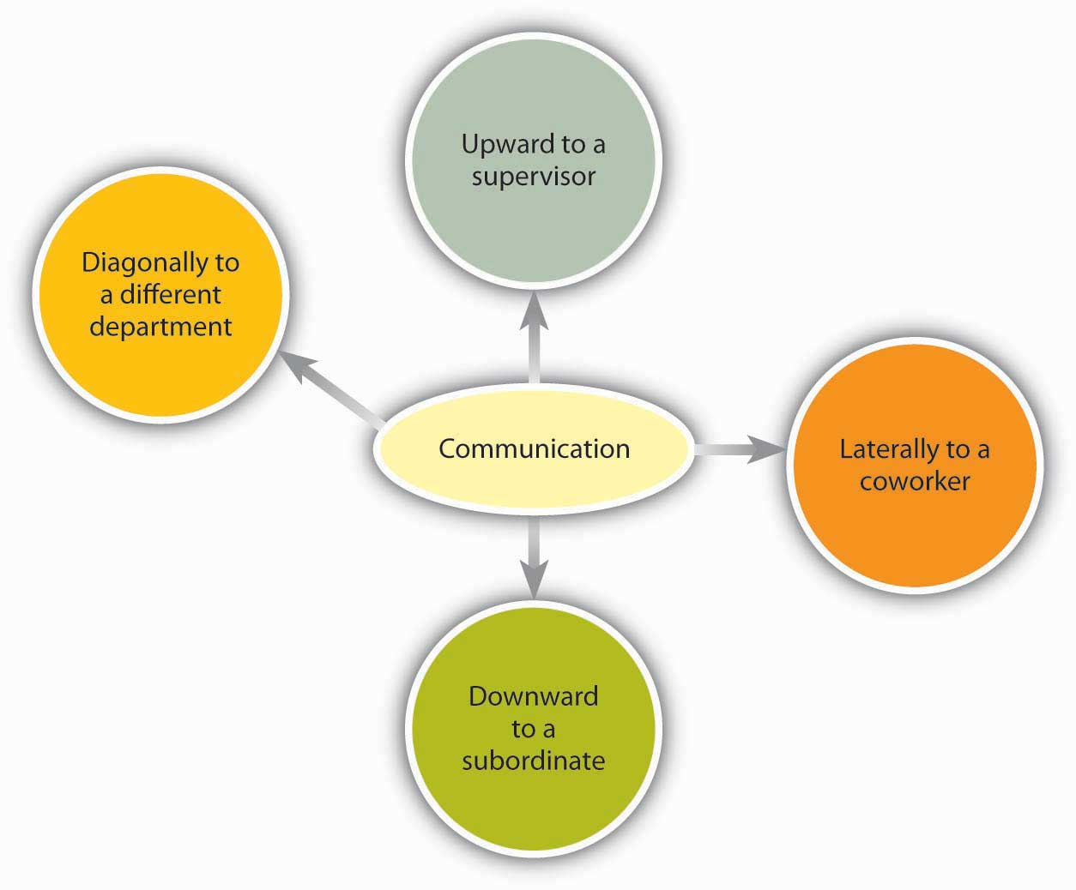
Channels/ Flow of Communication
Communication between/among the individuals working in an organization takes place through the following channels:

Slide 2

Channels/ Flow of Communication
Downward Communication
Upward Communication
Lateral/ Horizontal Communication
Diagonal/Cross-wise Communication

Slide 3

Downward Communication
Communication from the higher level in managerial hierarchy to the lower ones.
Provides direction and control.
For example: annual confidential report, performance appraisals, notices, project feedback, announcements of company policies, and official instructions etc.

Slide 4

Upward Communication
Communication from the lower level in managerial hierarchy to the higher ones.
Communication from subordinates to superiors.
Provides feedback on several areas of organizational functioning.
For example: Business proposals, a business report form the branch manager of a company to the managing director of the company, suggestion box, exit interviews, grievance committee and so forth.

Slide 5

Lateral/Horizontal Communication
Communication among professional peer groups or people working on the same level of hierarchy
Develops teamwork and promotes group coordination within an organization.
For example: Informal discussions, management gossip, telephone calls, teleconferencing, videoconferencing, memos, routines and meetings and so forth.

Slide 6

Diagonal/Cross-wise Communication
No rigid norms of communication protocols as it flows in all directions.
Advancement in science & technology, flexibility in system, fraternity and equality in the corporate sectors to reach the customers results in Diagonal communication.
For example: In printing company, all the functional divisions of a printing company like sales production and executives of higher levels work together to enhance business, and produce quality products.

Slide 7

Grapevine Communication
It is an informal network of communication, active almost in every organization.
Sometimes, some organizations undertake it consciously as it develops human resources which results in productivity.
For example: The chairman of Walt Disney, Michael Eisner moves among his employees to observe and talk to them to get an insight to change some strategies.

